Slide 1

Final Presentation
SVBRDF Estimation using a Physically-based Differentiable Renderer Markus Andreas Worchel

Slide 2
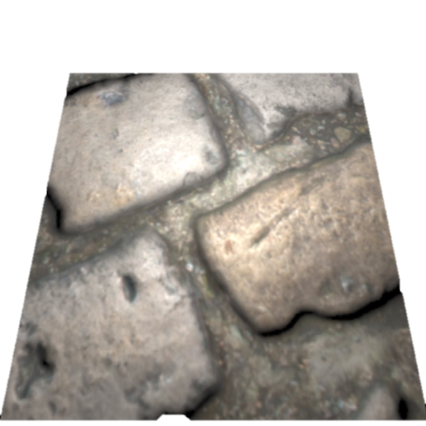
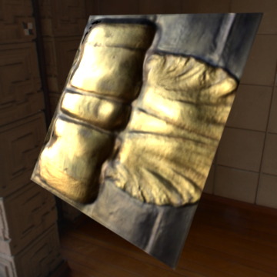
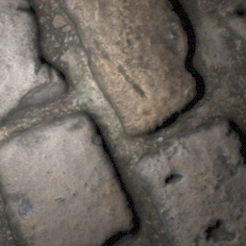
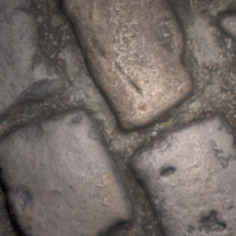
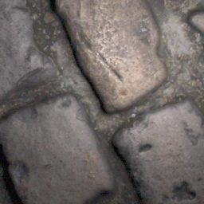
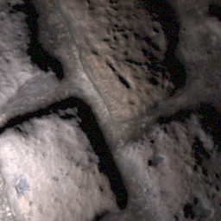
Recap – Topic
…
…
…
…
…

Slide 3
Recap – Approach
…
CNN
…
…
…
[1, 2]
…
[1] Deschaintre et al., 2018, Single-Image SVBRDF Capture with a Rendering-Aware Deep Network [2] Deschaintre et al., 2019, Flexible SVBRDF Capture with a Multi-Image Deep Network

Slide 4
Recap – Project Scope
Differentiable Pathtracer
[3]
…
CNN
…
…
…
[1, 2]
…
[1] Deschaintre et al., 2018, Single-Image SVBRDF Capture with a Rendering-Aware Deep Network [2] Deschaintre et al., 2019, Flexible SVBRDF Capture with a Multi-Image Deep Network
[3] Li et al., 2018, Differentiable Monte Carlo Ray Tracing through Edge Sampling

Slide 5
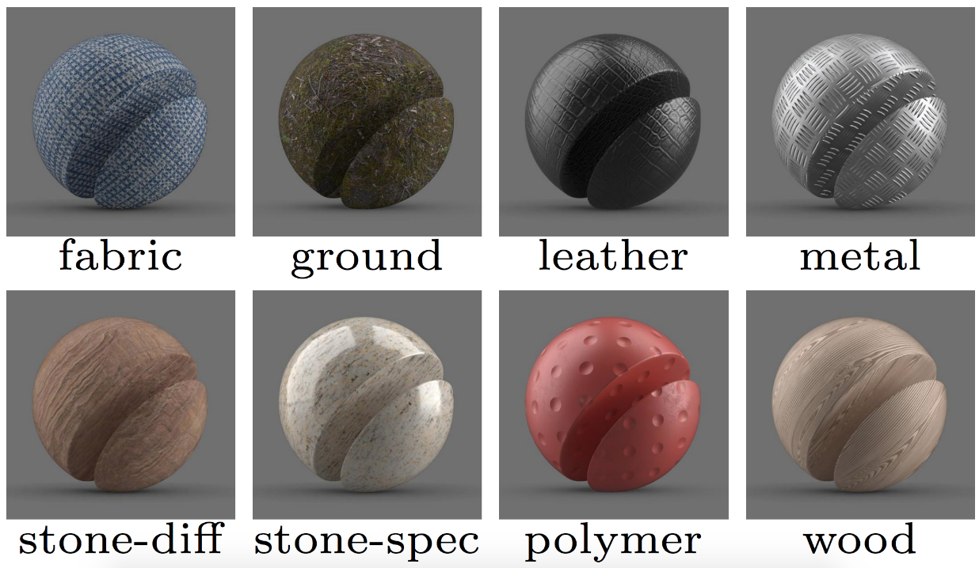
Recap – Motivation
Why material estimation?
Holistic 3D reconstruction (geometry + material)
Photorealistic assets for
Games
Movies
Cultural heritage
…
Multi material 3D printing
Why using a differentiable pathtracer?
General approach (independent of use case)
Flexible light transport simulations

Slide 6
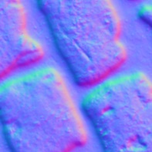
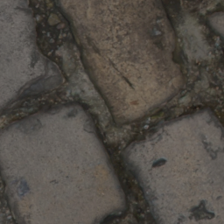
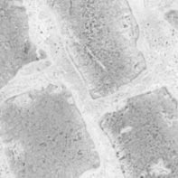

Algorithm – Data
LDR Image
Normal
Diffuse Albedo
Roughness
Specular Albedo

Slide 7



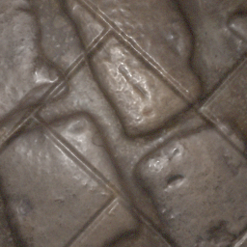
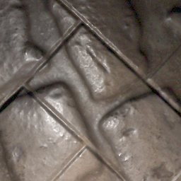
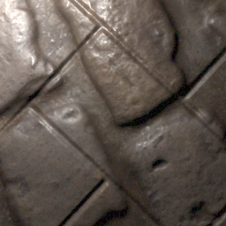
Algorithm – Data
Material mixing
Augmented image generation
…

Slide 8
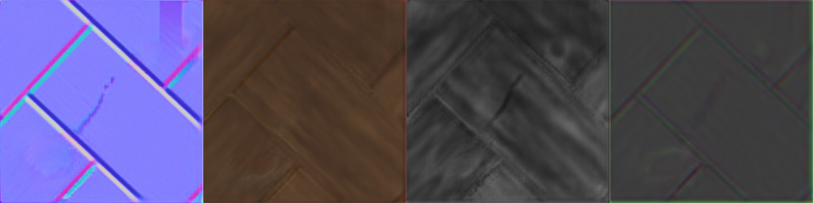

Algorithm – Overview
Data Reader
Encoder
Decoder
Loss
…
…
Global Track

Slide 9
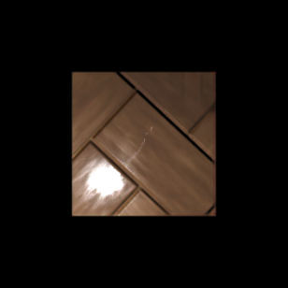

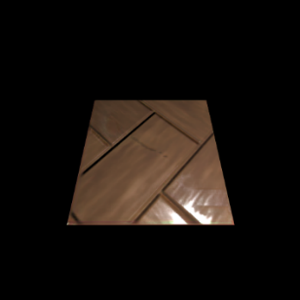
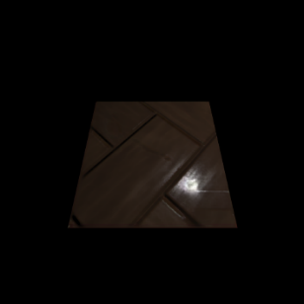


Algorithm – Loss
-
+
-
$$\underset{\text{L}\text{1 }\text{Loss}}{\underbrace{ }}$$
$$\underset{\text{Rendering} \text{Loss}}{\underbrace{ }}$$

Slide 10
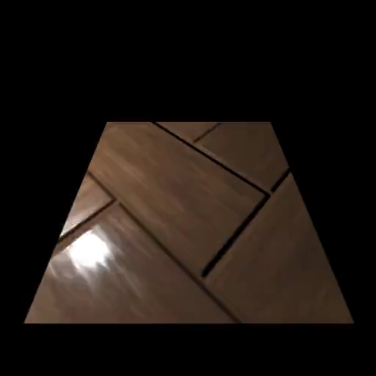
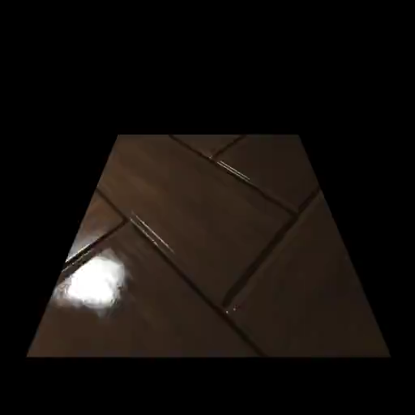
Algorithm – Differentiable Renderers
Renderer for direct illumination implemented using PyTorch (local)
Redner pathtracer implemented in C++
with PyTorch bindings (pathtracing)

Slide 11
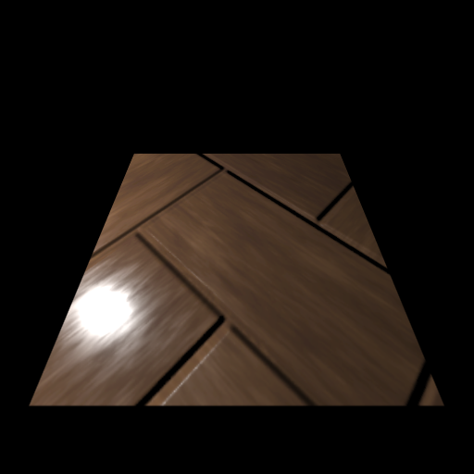
Algorithm – Renderer Output
Problem: No gradient information for weight optimization

Slide 12
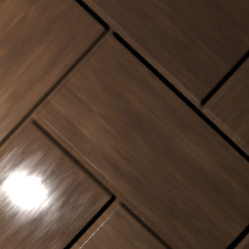
Algorithm – Renderer Output
Problem: No gradient information for weight optimization
Solution: Full patch sampling

Slide 13
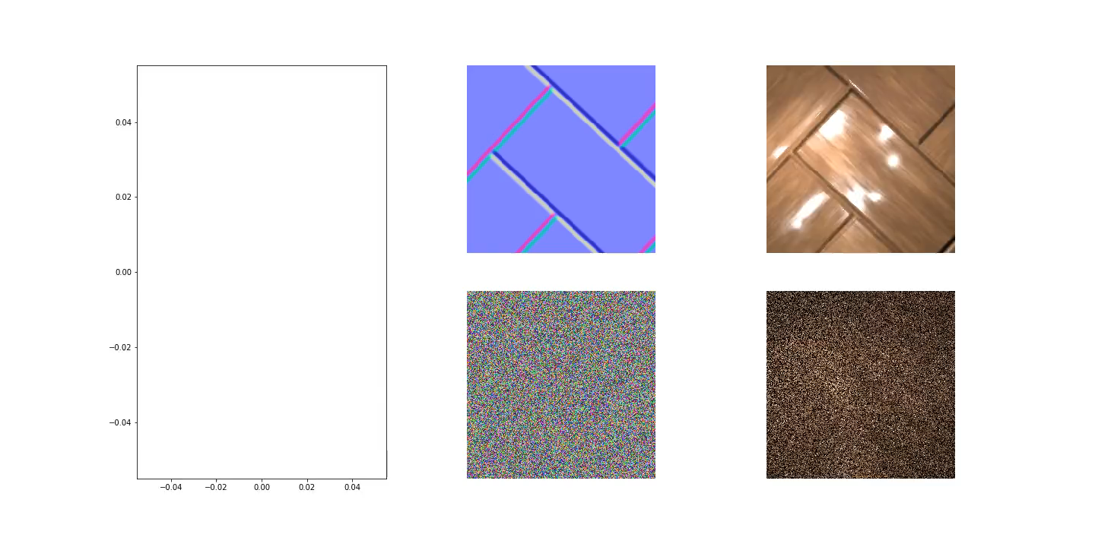
Algorithm – Patch Sampling in Redner
TODO: Explanation of manual derivates in C++ and video showing that the derivatives work (material optimization by comparing renderings)

Slide 14
Algorithm – Inference
TODO: Flowchart of the algorithm separated into Training and Inference (images, SVBRDF, image generation, data preparation, u-net encoder decoder, loss function (with renderers [direct illumination/pathtracing]))

Slide 15
Results
Qualitative comparison of reference results and re-implementation
Qualitative comparison of re-implementation direct illumination vs pathtracing
Quantitative comparison (training time, loss graphs)
Real world samples estimated by all methods
Videos / (interactive application?)

Slide 16
Limitations
Training time
Correlated feature maps
Metal

Slide 17
Future Work
BSDF estimation
Generic geometry
Optimized C++ implementation

